Slide 1
Tag Recommendation system (TRS)
Aalli Mahmood
Atefeh Safarkhah
Group 6
Muhammad Dawar
Mohammad Armoun

Slide 2
Idea
Recommend proper and related Tags for a question (Title and body) in order to :
Guide the question to the right points
Make the question clearer for the community.
Make search more precise and faster
Justification: Asking a question is part of learning process and we want to make sure that every question will be answered

Slide 3
Idea
What?
Question 1
Stack Overflow Infrastructure
User 1
User Interests
JS
C#
Why?
JS
HTML
CSS
Question 2
User 2
Cpp
lambda
pointer
Cpp
Java
Question 3
Question 1
User 1
C#
.Net
string
Question 3
Question 4
java
Android
thread
Question 2
User 2
Question 4

Slide 4
Data Abstraction
Account ID | User ID | Name | Reputation | Bronze | Silver | Gold
What?
User ID | Question ID | Title | Body | Score | View Count | Tags
User ID | Question ID | Title | Body | Score | View Count | Tags | Account ID | Name | Reputation | Bronze | Silver | Gold
Remove Useless Columns
Score, View Count and Reputation just help us to understand the Tags are valid. Not useful for training
Title | Body | Tags
String(Marked Up) | String(Marked Up) | String(Comma Separated)

Slide 5
Task Abstraction
Questions :
Domain Language
Task Abstraction
Are all Tags important for us?
Present trend of tags
How much each tag is repeated?
Discover the Distribution
Should we consider all tags for ML process ?
Identify the Trend
How can we improve our system?
Explore relations

Slide 6
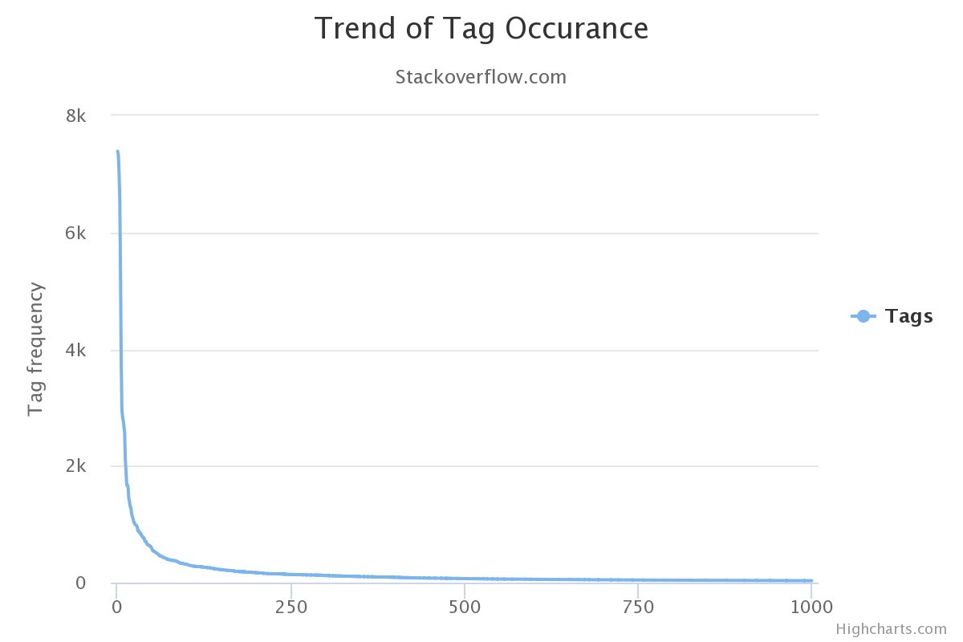
Present trend of tags
What?
Ordinal
How?
Line chart : Line
Why?
To find out and overview of how is the trend of tag occurrence

Slide 7
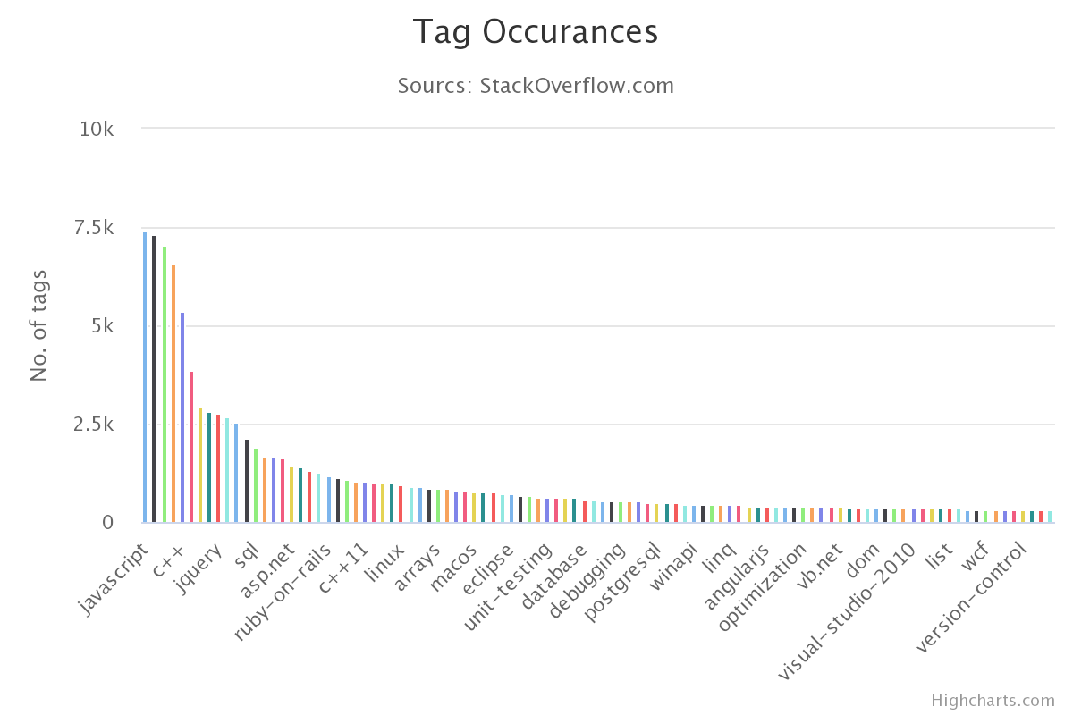
Discover the Distribution
What?
Ordinal
How?
Bar chart: Size encode
Also Hue encode because of the density of data (to be distinguishable)
Why?
To find out and overview of how many times each tag is repeated

Slide 8
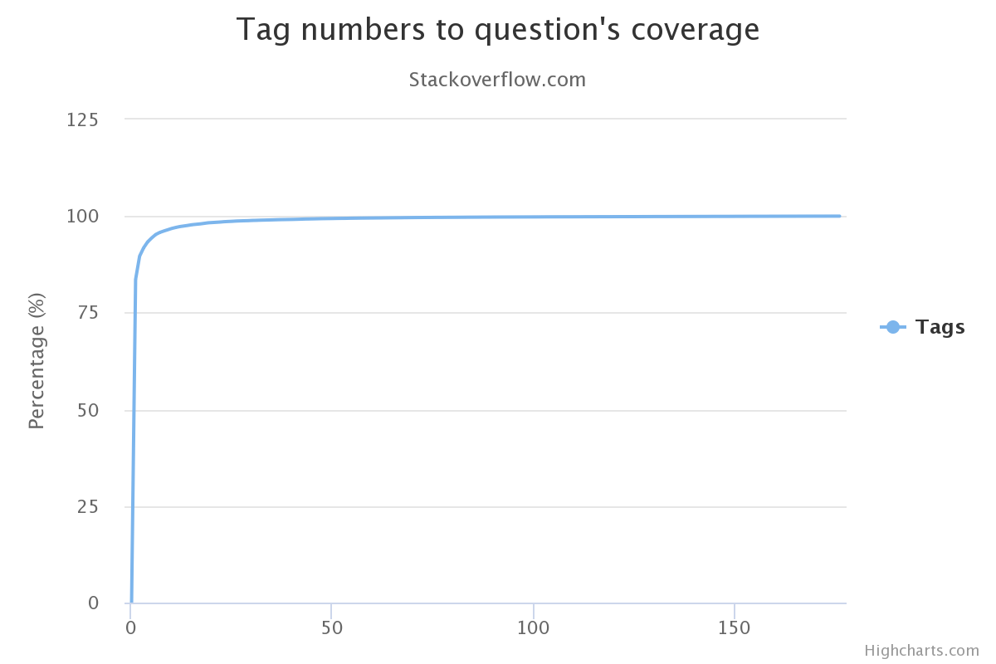
Identify the Trend
What?
Ordinal
How?
Line chart : Line
Why?
To find out how many tags can be selected to cover nearly most of dataset but prevent unimportant tags to be involved in training process

Slide 9
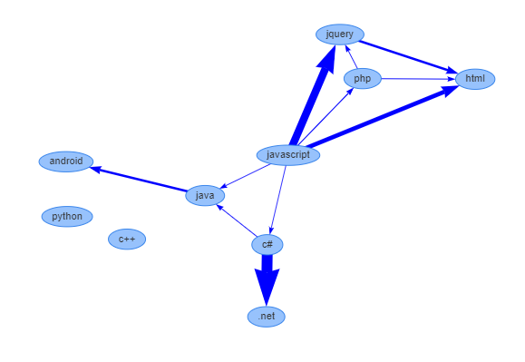
Explore relations
What?
Network
How?
Nodes: Top 10 Tags
Edges: How Strong is their relationship
(How many time they occur together)
Why?
Is there any relationship between occurrence of some tags ??

Slide 10
Conceptual Solution
Title | Body | Tags
String(Marked Up) | String(Marked Up) | String(Comma Separated)
What?
Is String useful for a Classification problem?
Most Probably Not
Solution??
Count Vectorizer
Vectorization
Convert text to number representation
TD-IDF Vectorizer

Slide 11
Conceptual Solution
What?
Why?
The relationship between Word is not important (no sequential processing is important)
On the other hand the proportion of a word against whole document is interesting for us

Slide 12
Conceptual Solution
What are the correct version numbers for C#?
What?
<p>What are the correct version numbers for C#? What came out when? Why can't I find any answers about <strong><em>C# 3.5</em></strong>?</p>
<p>This question is primarily to aid those who are searching for an answer using an incorrect version number, e.g. <strong><em>C# 3.5</em></strong>. The hope is that anyone failing to find an answer with the wrong version number will find <em>this</em> question and then search again with the right version number.</p>
Why?
506 letter
How?
Remove all codes (<code></code>)
Remove all HTML tags
Remove “Stop Words” (The, ‘a’ , of, …)
correct version number c# correct version number c# correct version number c# correct version number c# came find answer c# 3.5 question primarili aid search answer use incorrect version number c# 3.5 hope anyon fail find answer wrong version number find question search right version number.
Convert all string to lower case
Remove single character
294 letter
Stemming (searched, searching => search)
Combine 3 times Title + 1-time Body

Slide 13
Conceptual Solution
correct version number c# correct version number c# correct version number c# correct version number c# came find answer c# 3.5 question primarili aid search answer use incorrect version number c# 3.5 hope anyon fail find answer wrong version number find question search right version number.
What?
Why?
How?
'3.5' | '3.5 hope | '3.5 hope anyon' | '3.5 hope anyon fail' | '3.5 question' | '3.5 question primarili' | '3.5 question primarili aid' | 'aid' | 'aid search', | 'aid search answer'
0.0936 | 0.0468 | 0.0468 | 0.0468 | 0.0468 | 0.0468 | 0.0468 | 0.0468 | 0.0468 | 0.0468
1x161
TF-IDF parameters In our dataset:
min_df | max_features | smooth_idf | norm | tokenizer | sublinear_tf | ngram_range
0.0009 | 200000 | True | l2 | space_tokenize | False | Range(1,4)
114733x84000

Slide 14
Conceptual Solution (Machine Learning)
Problem: Multilabel (multiclass) classification
What?
Simplest Solution: One versus Rest classifier + Stochastic Gradient Descent
Why?
OnevsRest Classifier: Multilabel classification -> Multiple Single Label Classification
How?
Features 114733
Labels (Classes)
500
….

Slide 15
Conceptual Solution (Machine Learning)
Improvement:
Some Tags does not have any relations to each other
Create specific model for those tags that occur together
First Level
Model create by whole Labels
Second Level
c#, .net, asp.net, asp.net-mvc , linq
Java, Android
C++, C++ 11, C++ 14
Sql, mysql, sql-server, postgresql, sqlite

Slide 16
Technologies
Back-End
Front-End
Sklearn
Flask Web server
(Restful web service)
Html
CSS
Numpy
JavaScript
Pandas
React
Matplotlib
HighCharts
NLTK
Vis.Js
Joblib
MaterialDesign

Slide 17
DEMO

Slide 18
Overview (LA Reference Model)
What
Why
Predict a few tags for a new users how do not know how proper tags can makes their question more visible
To guild the question to the proper user who know the answer
How
Who
Using Machine learning,
A multilabel classification using OneVsRestClassifier and SGD
Users of the website, Community, Owners of the website

